Slide 1
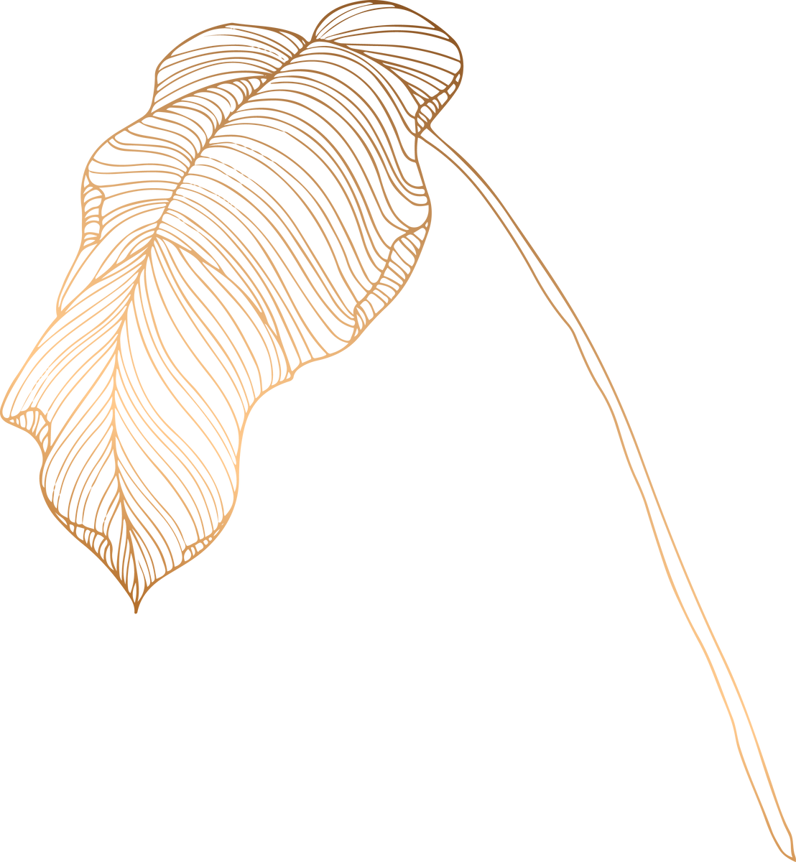
PREDICTION OF THE GENETIC DISORDER BEFORE BIRTH
Arya S

Slide 2
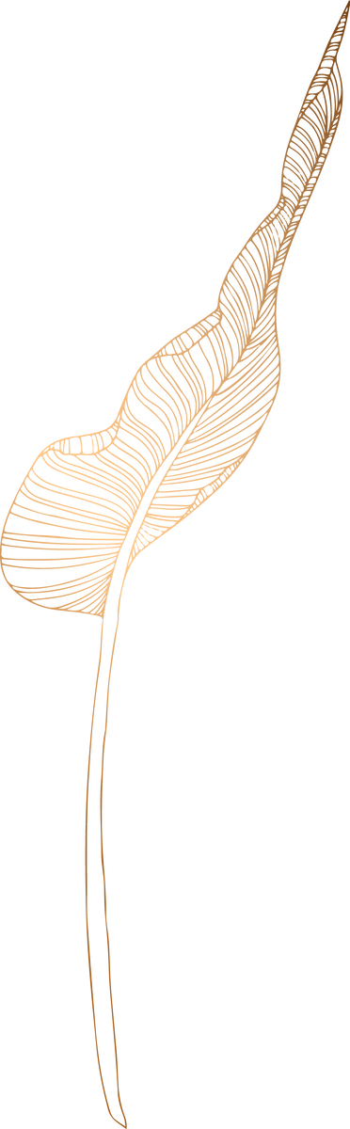
TABLE OF CONTENTS
Business Problem
Solution
Genes to look out for
Most common Disorders
Probabilities

Slide 3

BUSINESS PROBLEM
Approximately 3-5% of children born each year are affected by genetic disorders, which are abnormalities in their genetic material.
The current diagnostic tests for these disorders are invasive and only detect a limited number of common conditions.
There are many serious disorders that remain undetected, resulting in shortened life expectancy or even prenatal mortality.
It is important to note that invasive tests carry a significant risk of complicating pregnancies by multiple folds.

Slide 4
SOLUTION
THE SOLUTION LIES IN THE DEVELOPMENT AND IMPLEMENTATION OF NON-INVASIVE, COMPREHENSIVE GENETIC TESTING METHODS THAT TAKE INTO ACCOUNT VARIOUS RISK FACTORS. SIMULTANEOUSLY, INVESTING IN GENETIC RESEARCH AND FOSTERING COLLABORATION CAN FURTHER OUR UNDERSTANDING OF GENETIC DISORDERS, ULTIMATELY IMPROVING THE OUTCOMES FOR AFFECTED INDIVIDUALS AND THEIR FAMILIES.

Slide 5

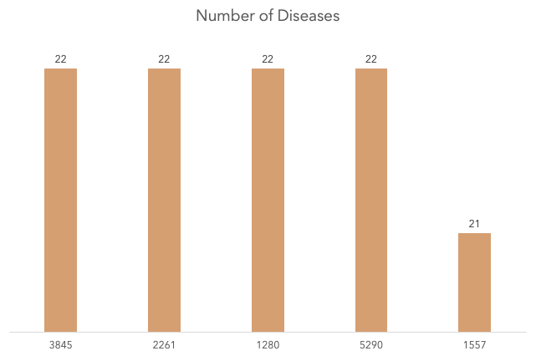
GENES RESPONSIBLE FOR MOST DISORDERS
Gene ID 3845, 2261, 1280, and 5290 have been identified as responsible for causing up to 22 different disorders. Additionally, Gene ID 1157 has the potential to cause 21 different disorders.
This highlights the complexity and diversity of genetic disorders, emphasizing the need for comprehensive and advanced testing methods.

Slide 6
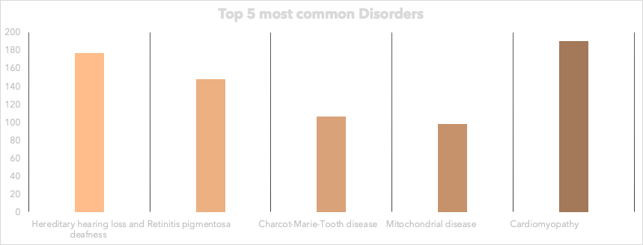
MOST COMMON DISORDERS

Slide 7
PROBABILITIES
Probability of getting a defect in the gene IDs 3845, 2261, 1280, and 5290 out of all gene IDs: 0.007139942880456956
Probability of getting a disease with associated genes: 0.6480909829406987
Probability of getting a disease with related genes: 0.3519090170593014
Probability of getting cardiomyopathy: 0.015434606011372868

Slide 8
MACHINE LEARNING MODEL
REQUIREMENTS
The dataset includes more information on genes
The dataset includes more genes
More information on 'How the disease or disorder can be caused
A conclusive way to test the hypothesis

Slide 9
THANK YOU

Slide 10
QUESTIONS?

